Slide 1
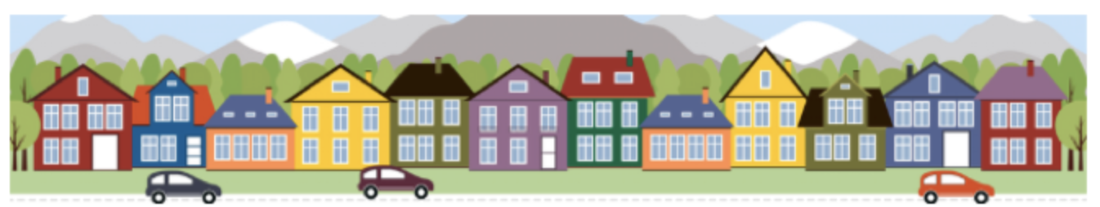
Ames House Price Prediction
Natasha

Slide 2
Outline
AMES
Real Estate Agent
Ready to assist you to get the best dream house you can get!
Takeaway
Take simple pointers to remember!
Findings
Giving you the data analysis so you don’t have to do it yourself
How do we get out data
Sharing you how we get the insights for you
Background
Why do you need to know this

Slide 3




Background
*Assumption: presentation was shared in 2011 with target audience as home buyers in Ames
** Disclaimer:Data was taken from houses sold in 2006-2010. Probably we will need to retrain our model with a more updated data to ensure better predictions if we would like to use it in 2022
$340,000 +
30-year mortgage
How?
Yes, it is expensive!
So how we can be more mindful on purchasing house?
What we can find?
Renovating? Purchasing a house?
Purchasing a house can be a huge commitment.
We might need to have a conventional 30-year mortgage!
1. to find out which features have greater impact to the house value
2. to find out how much they probably need to spend on purchasing a house with features that they want
Don’t waste time and money on renovating in features that is not significantly increase your house price?
Let us know what you want in a house and get a price prediction!
Why don’t we look at the previous data. We can better purchase or increase our house value.

Slide 4
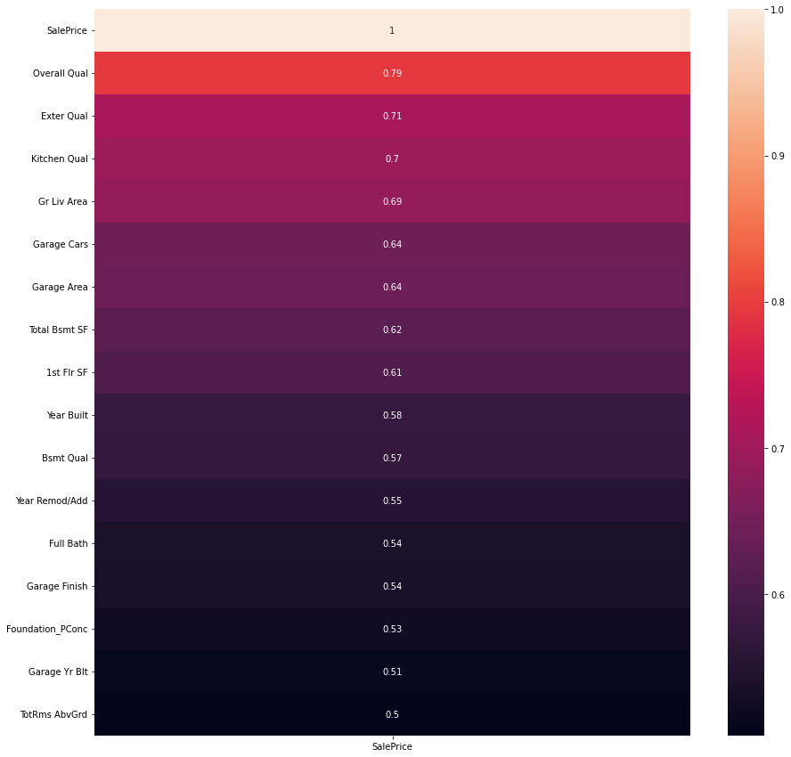
Data Overview
Category 3
2051 samples of residential properties sold between 2006 to 2010 in Ames, Iowa.
7 Categories of Data:
Location and Proximity
Square Footage
Quality and Condition
Parts of the Home
Utilities and Intangible Factors
Time Factors
Home Price [Target]
Category 2
First Glance on 2006-2010 Data
Notes:
The dataset has houses built in 1872-2010 with size ranging from 1300 to 159,000 sqrf. Some of the houses sold may have been remodeled as well. Overall the condition of the houses sold tend to be in average condition.
On average, the house sold has basement of 1058 sqrft with first floor of 1164 sqrft and second floor of 329 sqrft. The living area varies from 334 to 5642 sqr ft with garage size of 473 sqrft.
The price ranges from $12,789 to $611657

Slide 5
Criteria for Good Model
R²: R-squared is the percentage of the dependent variable variation that a linear model explains.
Root Mean Square: Measure of the differences between values (sample or population values) predicted by a model and the values observed. We want it to be smaller so that it has lesser deviation to True value

Slide 6

Pre Processing
Our model will fail if we have too many missing values
Columns with >50% missing values are removed: alley, pool quality, fence, and miscellaneous feature.
Filling up Missing Values on <50% missing values**
There are 13 columns with >85% data on one category: doesn’t tell us anything, not a good predictor.
>50% missing values
<50% missing values
Imputing 0 value for numerical features*
Imputing ‘NA’ for categorical features*
*Assuming those with no values have no such feature in it
**Effect: those imputed values might skew the data as they are treated as actual observations

Slide 7
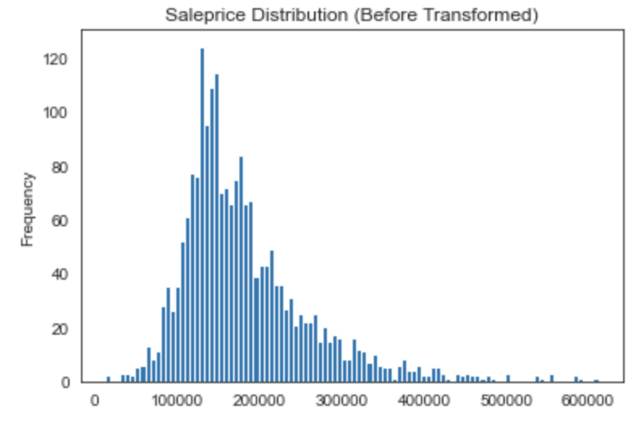
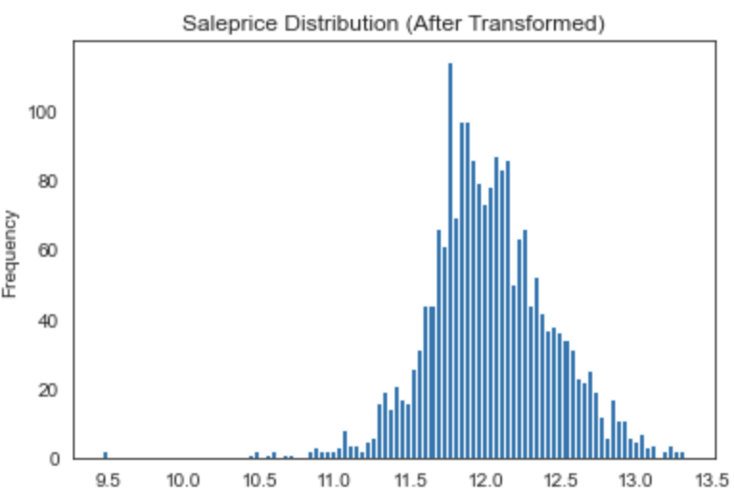
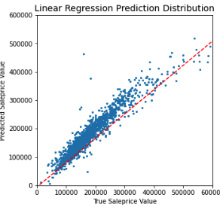
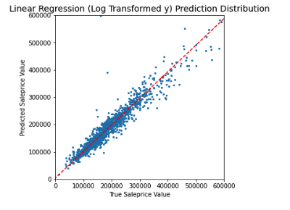
Model: Linear Regression with Target Price Transformed
We want to predict the sale price value based on the values of other features in the house, so we decided to use linear regression.
Transformation
Raw data is right skewed and to make better prediction, we need a normally distributed data or bell curve shaped. Therefore, we log transformed the sale price data.
Evaluation of the model
The model has an R2 score of 92.10% which means 92.10% variability can be explained by all of our features selected. This score performs better than the one that is not transformed. This is also supported by the lower RMSE value of $23,650 vs $25,032 of the one that is not transformed.
The lower RMSE means that we can have better prediction as there is lower difference between our prediction and the true value.
Predicted Value vs True Value
Right Skewed
Bell Curved Shape
Fit much better

Slide 8
Takeaway from Lasso Coefficient
Factors Affecting Price
*although lasso is not chosen, but we can deduce some information from the lasso coefficient regarding features boost or hurt the sale price

Slide 9
Factors with Significant Effect on Price
Factor | Effect on Price
Green Hills (Neighborhood) | 71750.48
Stone Brook ((Neighborhood) | 52742.28
Northridge Height (Neighborhood) | 40679.89
Northridge (Neighborhood) | 29615.38
General Living Area | 20794.06
Overall Quality (material and finish of the house) | 19010.63
Factor | Effect on Price
Mansard (Roof Style) | -23605.43
Edwards (Neighborhood) | -16088.99
Stucco (Exterior) | 12656.15
Brick (Masonry Veneer Type) | -12579.21
Quick and significant rise from street grade to building (Land Contour) | -10818.

Slide 10
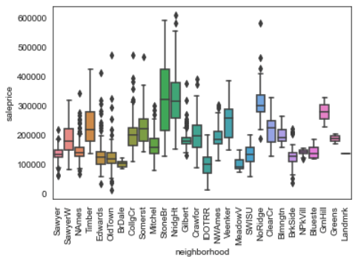
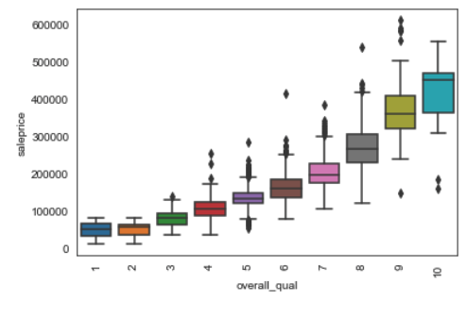
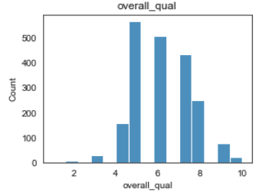
Takeaway
Choosing a neighborhood is very crucial, if possible home buyers can avoid Edwards, Old Town and buy somewhere near northbridge area or greenhills.
Choose a better overall quality to be able sell in better price in the future. Most of the house sold has rating 5 and above or home seller can do renovation or remodelling on the old houses to be able to sell in higher price

